Slide 1
MENTORNESS AIRPLANE CRASH ANALYSIS

Slide 2
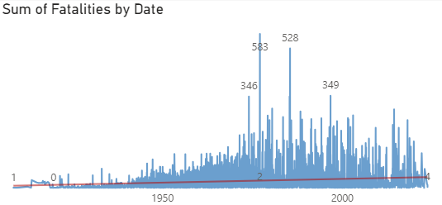
Temporal Analysis:
Approximately 155,000 individuals were aboard aircraft involved in crashes.
Around 112,000 individuals lost their lives in these crashes.
Approximately 9,000 individuals on the ground were affected by these crashes.
There were approximately 43,000 survivors of these incidents.
The data shows a consistent increase in airplane crashes from 1908 to 2023. However, a notable surge is evident from 1973 onwards. In particular, the year 1977 stands out with the highest number of recorded crashes among the analyzed years.

Slide 3
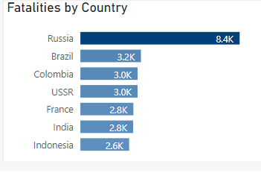
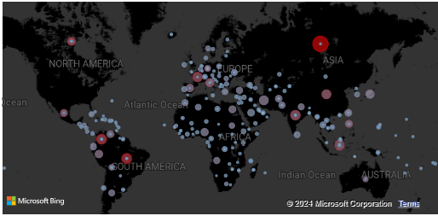
Geospatial Analysis:
The map illustrates fatality rates per country resulting from airplane crashes. Russia leads with approximately 8.4k fatalities, followed by Brazil (3.2k), Colombia (3k), the USSR (3k), France (2.8k), India (2.8k), Indonesia (2.6k), and others."

Slide 4
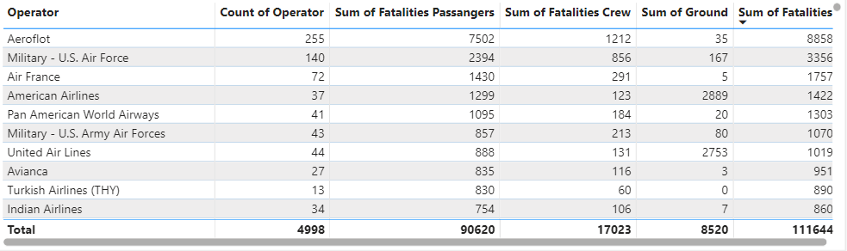
Operator Performance:
The table reveals the operators with the highest fatalities from airplane crashes. Aeroflot leads with 8,858 fatalities, followed by the US Air Force Military (3,356), Air France (1,757), American Airlines (1,422), Pan American World Airways (1,303), and other operators."

Slide 5
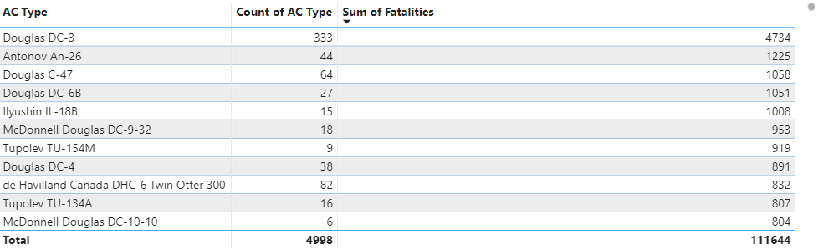
Aircraft Analysis:
The table displays aircraft types with the highest fatalities from airplane crashes. The Douglas DC-3 tops the list with 4,734 fatalities, followed by the Antonov An-26 (1,225), Douglas C-47 (1,058), Douglas DC-6B (1,051), Ilyushin IL-18B (1,008), and other aircraft types.

Slide 6
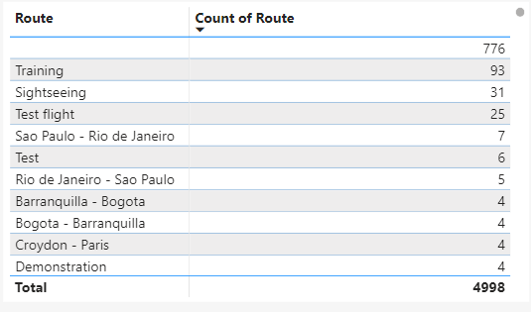
Route Analysis:
The table illustrates routes with the highest airplane crashes. The most common routes involved were Training flights (93 observations), followed by Sightseeing (31), Test flights (25), Sao Paulo to Rio de Janeiro (7), Test routes (6), Rio de Janeiro to Sao Paulo (5), and others.

Slide 7
Recommendation:
Safety Measures for High-Risk Operators: Operators with the highest fatalities, such as Aeroflot and the US Air Force Military, should prioritize implementing rigorous safety measures, including thorough training programs, regular maintenance checks, and adherence to strict safety protocols.
Aircraft Maintenance and Upgrades: Aircraft types like the Douglas DC-3 and Antonov An-26, which have recorded significant fatalities, should undergo comprehensive maintenance checks and, if feasible, consider upgrades or replacements with newer and safer aircraft models.
Enhanced Training and Oversight for Specific Routes: Routes with frequent crashes, such as Training flights and Sightseeing tours, should receive enhanced training programs for pilots and crew, as well as increased oversight and regulation to ensure compliance with safety standards.
Route Optimization and Risk Assessment: For commercial routes like Sao Paulo to Rio de Janeiro, where crashes have occurred, airlines should conduct thorough risk assessments, consider route optimization strategies, and prioritize passenger safety above all else.
Collaborative Safety Initiatives: Collaboration between aviation authorities, operators, and manufacturers is crucial to identify trends, share best practices, and implement industry-wide safety initiatives to prevent future accidents.
Continuous Monitoring and Improvement: Constant monitoring of safety data, incident reports, and technological advancements is essential for identifying emerging risks and implementing proactive measures to mitigate them.

